Slide 1
Barbershop Simulation
GPSS

Slide 2
GPSS
In GPSS programs are not written, but a block diagram is constructed, performing some simulation.
It provides access to 48 different blocks to be chosen for carrying out a desired operation.

Slide 3
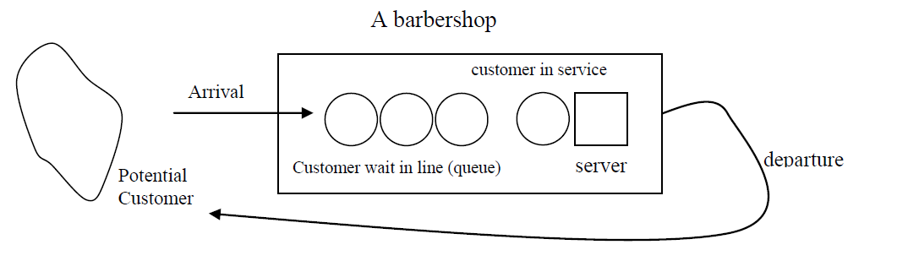
Barber’s Shop – System model

Slide 4
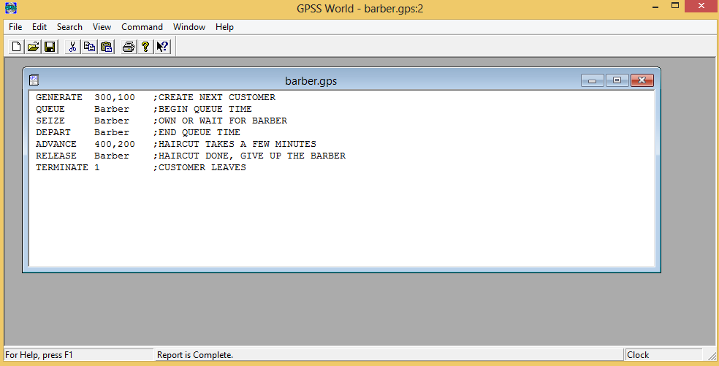
Model Text Window - GPSS

Slide 5
Blocks Description
GENERATE – creates transactions.
GENERATE 300, 100
QUEUE – updates queue entity statistics.
QUEUE Barber
SEIZE – active transactions waits for a ownership.
SEIZE Barber
DEPART – indicates reduction in the content of queue.
DEPART Barber
ADVANCE – delays progress of a transaction for a spec. Amount of time.
ADVANCE 400, 200

Slide 6
Blocks Description (contd.)
RELEASE – removes the ownership of a facility
RELEASE Barber
TERMINATE – reduces the active transaction from the simulation
TERMINATE 1

Slide 7
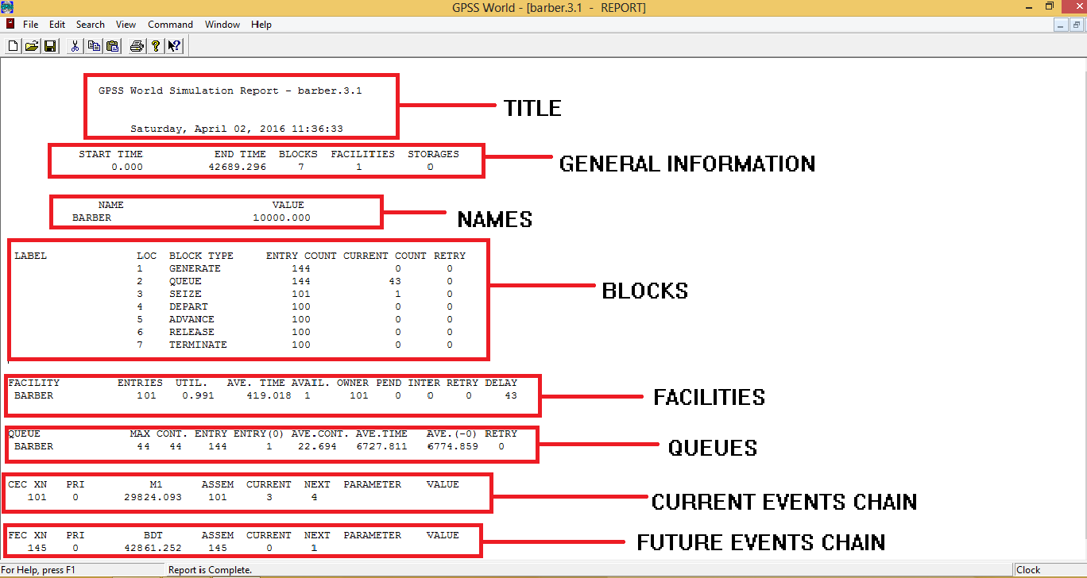
The Report window

